Slide 1

INC300
Week 12
Invisible Labour
Amanda Piche, PhD Candidate
August 9th, 2018

Slide 2
Today’s Agenda
Check-in
Lecture (first half of class)
Test #2 (second half of class)

Slide 3
Lecture 12: Invisible Labour
Learning Outcomes:
Describe examples of some of the “behind the scenes” jobs associated with social networking sites.
Define “the cloud” and “cloud computing” and explain how they relate to social networking sites.
Use the concept of precarious labour in relationship to social media content creation.
Explain the key elements of the “United Breaks Guitars” case study to explain why companies need an active social media participation strategy.
Describe what content moderation is and provide examples about why it is necessary in the context of social networking sites.

Slide 4

Week 11 Recap
Understand what personal and professional networking is, and why matters
Understand the distinction between personal and professional social networks, and how to balance the two
Utilize social media to maximize your professional network

Slide 5

Social media and “the Cloud”
Intel is best known for making computer chips and processors. In early 2017, they released a new commercial highlighting that 98% of the cloud runs on Intel processors. According to this commercial, the cloud is what allows ridesharing apps such as Uber or Lyft to operate, and it is also the reason that driverless cars can exist. While this commercial doesn’t mention it directly, the cloud is also an integral part of your experience using a social networking site. But what exactly is “the cloud”?

Slide 6

Social media and “the Cloud”
When the phrase “the cloud” is used, it is usually to invoke it as a metaphor to describe the Internet. Another term used alongside “the cloud” is cloud computing. It turns out that the definition of the term – and who created it – can be a bit difficult to pin down.
“Some accounts trace the birth of the term to 2006, when large companies such as Google and Amazon began using “cloud computing” to describe the new paradigm in which people are increasingly accessing software, computer power, and files over the Web instead of on their desktops.” (Regalado, 2011, para. 2)
However, in his article for the MIT Technology Review, Antonio Regalado was able to trace back the first usage of “cloud computing” to George Favaloro and Sean O’Sullivan who coined the term in 1996.
Notes:
Regalado, A. (2011, October 31). “Who Coined ‘Cloud Computing’?”. MIT Technology Review. Available: https://www.technologyreview.com/s/425970/who-coined-cloud-computing/

Slide 7

Social media and “the Cloud”
Much like “Web 2.0”, which we learned about at the start of this course, “the cloud” and “cloud computing” are terms that are frequently used but the definition can be difficult to pin down because they rely on metaphors that may mean different things to different people.

Slide 8

Social media and “the Cloud”
To avoid further confusion, the US government tasked the National Institute of Standards and Technology, division of the United States of America’s Department of Commerce, to come up with a definitive definition. After some deliberation, the following definition of cloud computing was offered:
  “Cloud computing is a model for enabling ubiquitous, convenient, on-demand network access to a shared pool of configurable computing resources (e.g., networks, servers, storage, applications, and services) that can be rapidly provisioned and released with minimal management effort or service provider interaction.” (Mell & Grance, 2011, p. 2)
Notes:
Mell, P. & Grance, T. (2011). The NIST Definition of Cloud Computing: Recommendations of the National Institute of Standards and Technology (Special Publication 800-145). Gaithersburg, MD: National Institute of Standards and Technology.

Slide 9

Social media and “the Cloud”
A less jargon-filled definition might be:
  “The cloud refers to software and services that run on the Internet, instead of locally on your computer. Most cloud services can be accessed through a Web browser like Firefox or Google Chrome, and some companies offer dedicated mobile apps. Some examples of cloud services include Google Drive, Apple iCloud, Netflix, Yahoo Mail, Dropbox and Microsoft OneDrive.” (Cha, 2015, para. 4)
Notes:
Cha, B. (2015, April 30). “Too Embarrassed to Ask: What Is ‘The Cloud’ and How Does It Work?”. Re/Code. Available: http://www.recode.net/2015/4/30/11562024/too-embarrassed-to-ask-what-is-the- cloud-and-how-does-it-work

Slide 10
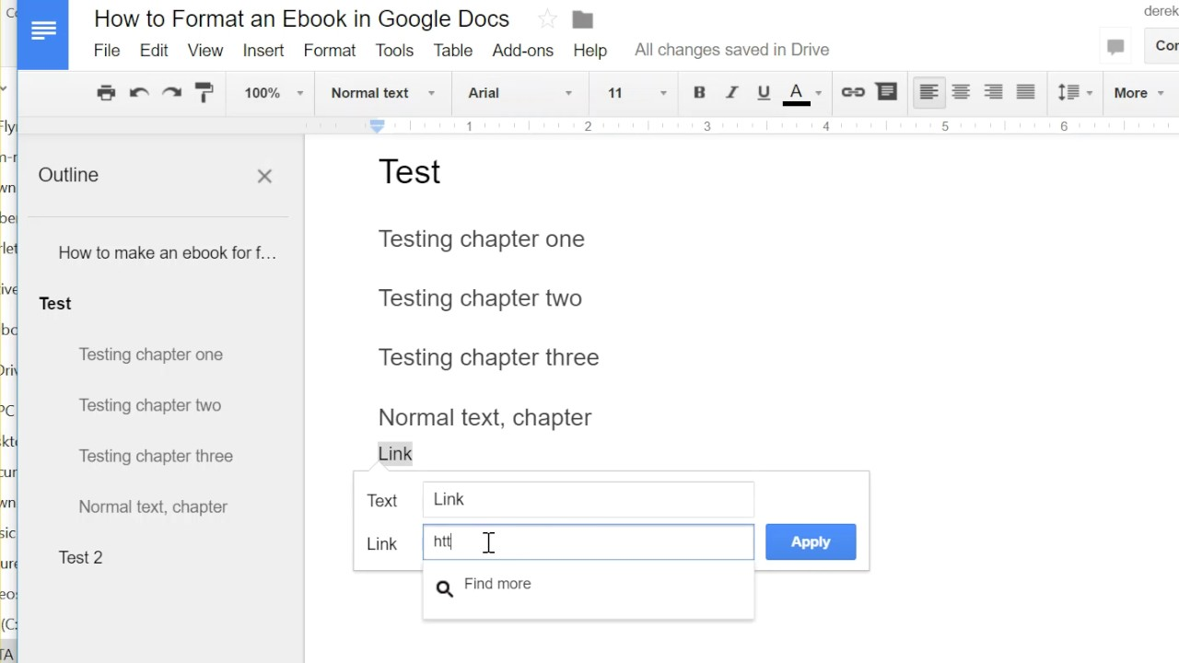


Notes:
Previously, you would write an essay on your computer, saving it to your internal hard drive. If you started your essay at home but wanted to finish it on campus, you would have to save a copy and bring it with you on an external memory stick or a portable hard drive. Compare that to writing an essay in Google Docs. As long as you have an Internet connection and remember the password to your account, you can pick up where you left off at home, school, or a friend’s house. The document is updated in real time, any time you log into your Google account you would be accessing the most recent version of your file, even if you are connecting with a different computer or phone than you had used previously. This is because by using Google Docs you are no longer saving your document locally. Instead, it is being saved to Google’s servers, which you have connected to via an Internet connection.

Slide 11
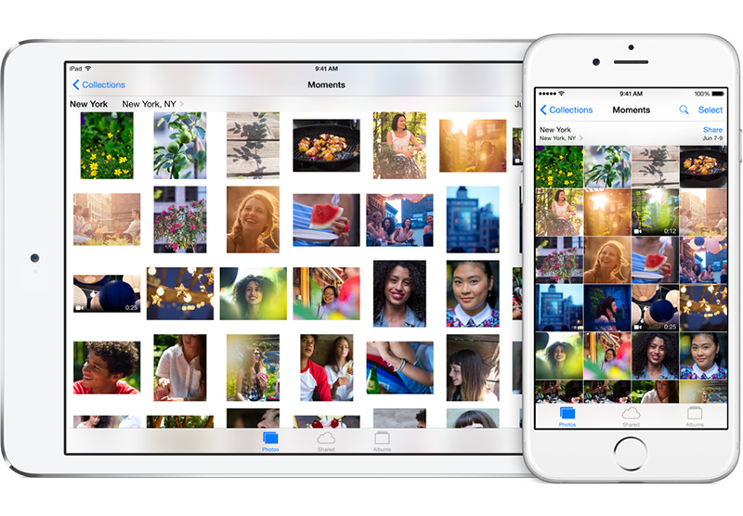

Notes:
Another example would be taking a picture using your phone. You can save the picture to your phone’s internal memory, it will be held there on your phone until it is deleted. If you were to take that photo and upload it to a photo sharing social networking site (e.g. Instagram, Flickr, etc.) a copy of that photograph would be transferred to the site’s server. This is what allows your friends and followers to view the content at any time from their own devices, even if you are not currently online or logged in to the site.
Both Google Docs and photo sharing sites such as Instagram are examples of how seamlessly “the cloud” has been integrated to our day-to-day lives.

Slide 12
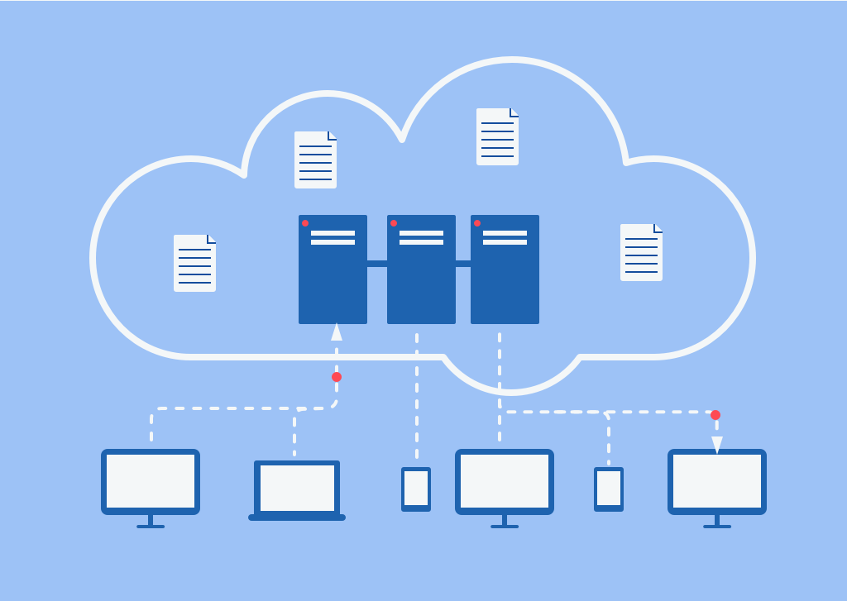
“The Cloud” is a real place
The cloud and cloud computing are both powerful ways to describe this decentralized approach to saving and sharing files because the terms capture the wire-free connections we now rely on. Because so many of us carry around smartphones – essentially pocket sized computers – we can easily forget that while we can’t see it, the cloud is a real, physical place housed in a data center.

Slide 13

“The Cloud” is a real place
When you store something “in the cloud,” you’re actually storing it in a very physical space. That file slides across the wire and then lives on a physical server - usually more than one - in some far-flung place. Depending on which cloud storage service you use, that file is now in the possession of a giant corporation to whom you probably pay a monthly fee. Anybody who’s ever used Dropbox knows that this makes it incredibly convenient to access files or to share files from any computer with an internet connection.
In the past, you just bought a computer with a hard drive inside and stored your files there. Now, you pay a company like Apple or Google to store the file remotely and provide you with access when you ask for it.
If your data lives “in the cloud,” it actually lives on a company’s server, and you more or less pay a membership fee to work in that company’s sandbox. Depending on that company’s terms of service, you may or may not actually own or control that data once it lives in cloud storage.
Notes:
Clark Estes, A. (2015, January 29). “What is “The Cloud” – and where is it?” Gizmodo. Available: http://gizmodo.com/what-is-the-cloud-and-where-is-it-1682276210

Slide 14

“The Cloud” is a real place
One final important note is that while data centers are easy to forget about because they are so far removed from our day to day lives, they have a very real environmental footprint:
“They [data centers] are large infrastructures that take up a lot of space (often equivalent to several football fields). They locate in small rural towns. They consume the electricity equivalent to small cities. They use a discourse of innovation and an “economy of scales” argument to justify their consumption. They employ only a small number (if any) of local inhabitants (proportionally to the size and excluding construction contracts). They are proliferating at exponential rates. And, they do not function without water – millions of gallons of it each day.” (Hogan, 2015, p. 4)
Now that we have looked behind the scenes of the cloud, let’s turn our attention to the behind the scenes labour that goes into making content for the web.
Notes:
Hogan, M. (2015). “Data flows and water woes: The Utah Data Center”. Big Data & Society. 2(2), 1-14.

Slide 15
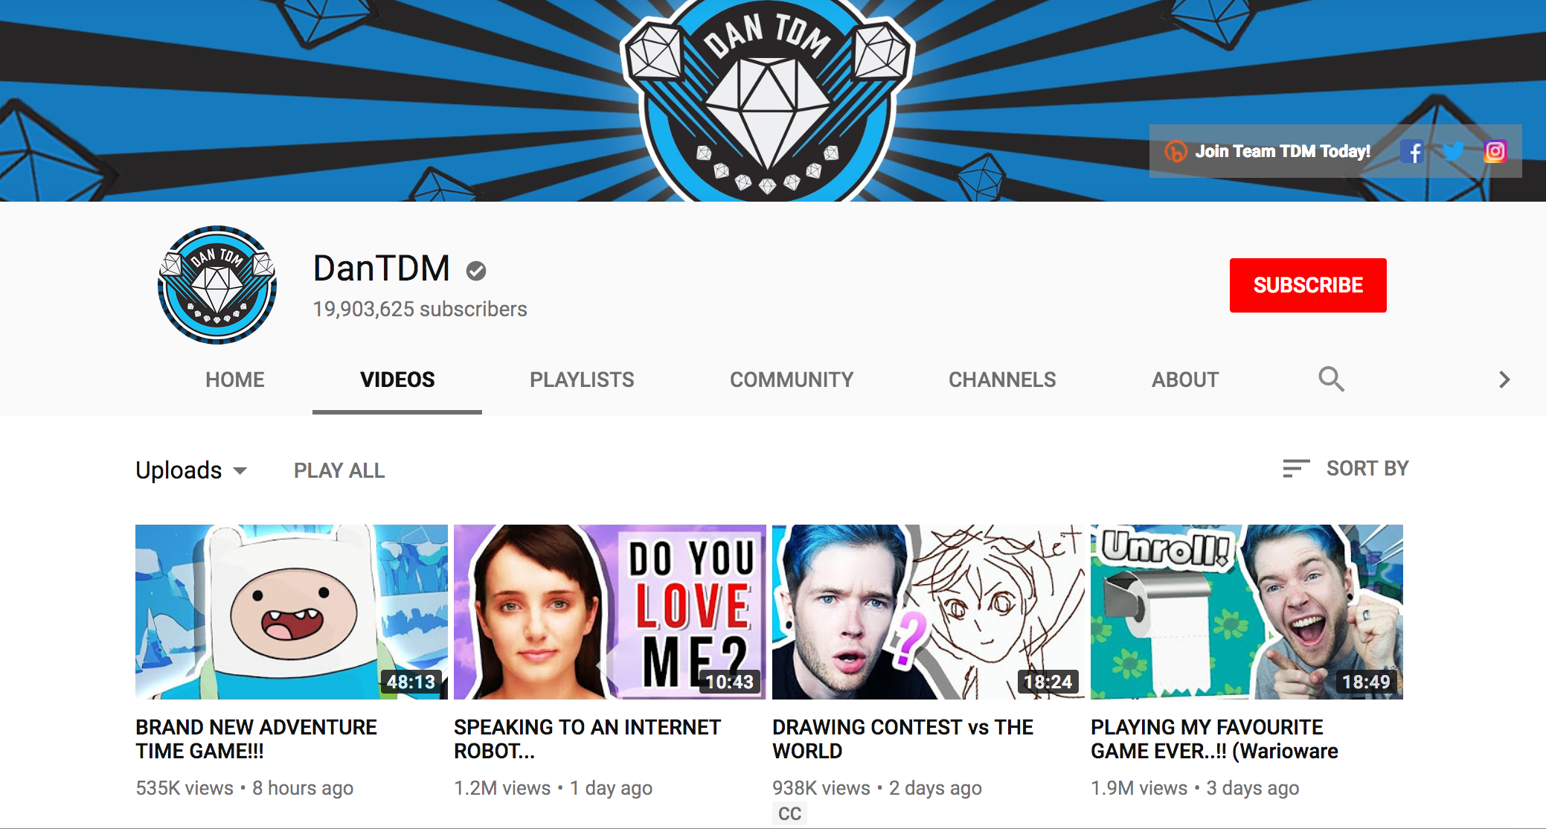
Making a Living on the Web: Content Creators
Thanks to large subscription numbers and millions of views on each video he posts, Daniel Middleton - better known as “DanTDM’-- is a YouTube content creator (focused on videogames) who has been able to make a living from his videos. It is estimated that Middleton made $16.5 million in 2017 from these videos. He and other well-known YouTubers who draw a sizeable income from their videos are often the subject of entertainment and business reporting (ex. Forbes), highlighting their financial successes by being an active content creator on the site.
Notes:
https://www.businessinsider.com/highest-paid-youtube-stars-2017-12

Slide 16
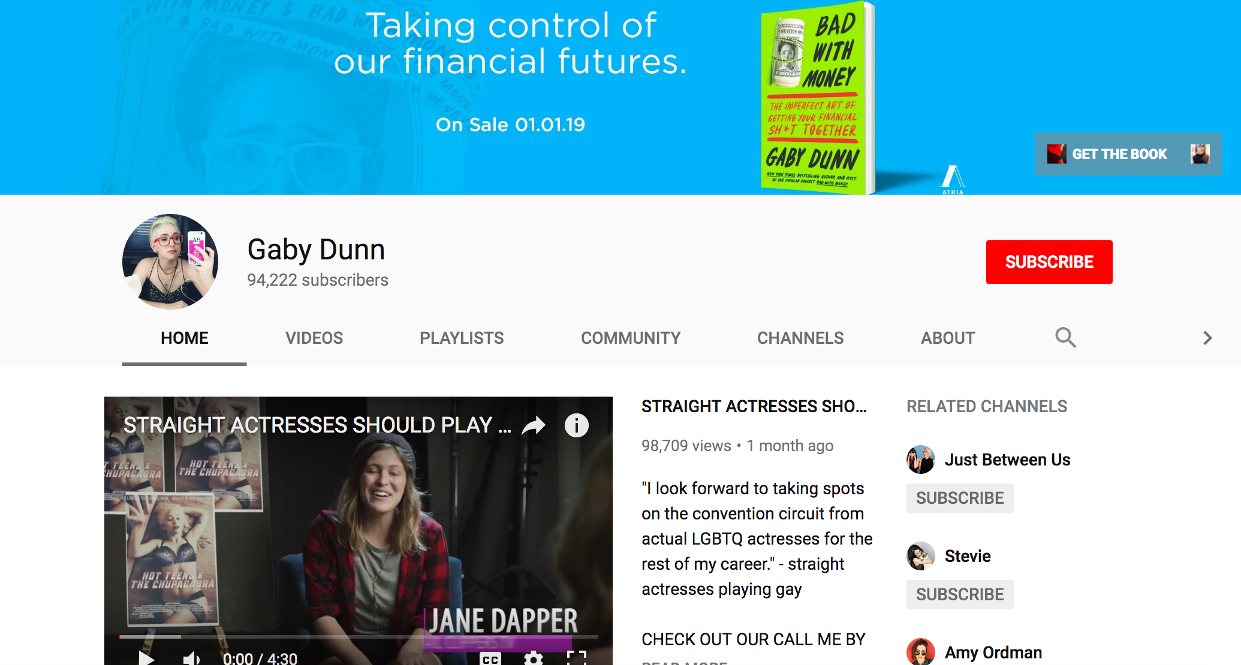
Making a Living on the Web: Content Creators
While stars like Middleton have made enough money off their videos to live comfortably, this is not actually the reality for many other well-known YouTubers. The first reading associated with this lecture , Gabby Dunn’s “Get Rich or Die Vlogging”, illustrates that having a popular channel and being a recognizable YouTube personality does not always lead to financial success. In her article, Dunn describes the experiences of both herself and her friends who are well known enough to be recognized on the street. There is the assumption that Dunn and her friends are as rich as Middleton, but as the article so clearly demonstrates is hardly ever the case.

Slide 17
Making a Living on the Web: Content Creators
Making content for YouTube or other social networking sites can be a time intensive process. In this interview with Brandon Bowen, a well-known user of (the now defunct social networking site) Vine, he explains how much time it can take to plan, shoot, and edit a 6 second video clip.
The interviewer expresses her disbelief that it can take several hours “for just six seconds” of video footage. Much like how the data centers that are needed for the cloud to run are hidden from view, so too is all the time and effort that goes into making content for sites like YouTube, Vine or other social networking sites.
Notes:
<<Need to put a video here>>

Slide 18

Making a Living on the Web: Content Creators
When reporting about content creators focuses on how easy it can be to make money on a social networking site, it will inevitably encourage newcomers to try their hand at it too. Unfortunately it is very rare to be financially successful from day one. Instead, new creators might follow a “fake it until you make it” approach or fall prey to the assumption that working for free in exchange for promotion will eventually be rewarded with financial compensation.
Notes:
<<Need to put a video here>>

Slide 19
Making a Living on the Web: Content Creators
In an update to “Get Rich or Die Vlogging”, Dunn is more explicit in her advice to avoid falling into the trap that working for little or no money in exchange for “exposure”. She explains the problem with working for exposure in detail and her overall argument summarized in this quote:
“Not too long ago, I was desperate for paid work, so I gave away a lot of my ideas and rights. In 2013 I was a staff writer for the website Thought Catalog and they asked me if they could publish a book of my previously published TC essays. An editor and I put it together while I was a salaried employee for no extra money. I did not receive any bonus or commission on sales of the book. But wow! I had gotten to publish a book! Incredible! Three years later, I no longer work at TC. I am more well-known and have more fans. These fans find the book and excitedly purchase it thinking they’re supporting me. But I don’t see any of that money. The more high-profile I become, the more the book sells for Thought Catalog.” (Dunn, 2016)
“Get Rich or Die Vlogging” serves as a reminder that for all but a few highly paid stars, making a living via social media is yet another form of precarious labour. This is work that is not stable, poorly paid, and does not have the protections that come with more traditional forms of employment (labour laws, health insurance, union membership, etc.).
Notes:
Dunn, G. (2016, June 23). “Take it from a viral media star: Stop signing away your ideas”. Fusion. Available: http://fusion.net/story/318054/buzzfeed-video-non-compete-owning-work-youtube/

Slide 20
The people behind the brands on social networking sites
Throughout this course, we have explored both the pros and cons of participating in social networking sites as a means for constructing your personal, professional identity. On one hand, by actively participating in social networking sites, you are able to curate an online representation of yourself that best reflects the traits and attributes you would like to share with the world (Theorizing Identity lecture). On the other hand, participation comes at a cost - social networking sites leverage your personal data to sell advertisements and your privacy cannot always be guaranteed.
Notes:
<<Need to put a video here>>

Slide 21
The people behind the brands on social networking sites
Corporations and brands face a similar dilemma about whether or not to create a social networking site presence. Business professor Jan Kietzmann, along with his co-authors, wrote an award-winning article making the argument that social media has forever changed how corporations interact with their customers.
Here they argue that the decision you must make at the end of this course (whether or not to engage/remain engaged in social networking sites) is a decision that must be made by corporations too:
“With this rise in social media, it appears that corporate communication has been democratized. The power has been taken from those in marketing and public relations by the individuals and communities that create, share, and consume blogs, tweets, Facebook entries, movies, pictures, and so forth. Communication about brands happens, with or without permission of the firms in question. It is now up to firms to decide if they want to get serious about social media and participate in this communication, or continue to ignore it. Both have a tremendous impact.” (Kietzmann et al., 2011, p. 242).
Notes:
Kietzmann, J. H., Hermkens, K., McCarthy, I. P., & Silvestre, B. S. (2011). Social media? Get serious! Understanding the functional building blocks of social media. Business Horizons, 54(3), 241-251.
<<go back and put in a video>>

Slide 22

The people behind the brands on social networking sites
“Social media introduce substantial and pervasive changes to communication between organizations, communities, and individuals. This presents an enormous challenge for firms, as many established management methods are ill-suited to deal with customers who no longer want to be talked at; instead, customers want firms to listen, appropriately engage, and respond.” (Kietzmann et al., 2011, p. 250)
Notes:
Kietzmann, J. H., Hermkens, K., McCarthy, I. P., & Silvestre, B. S. (2011). Social media? Get serious! Understanding the functional building blocks of social media. Business Horizons, 54(3), 241-251.

Slide 23
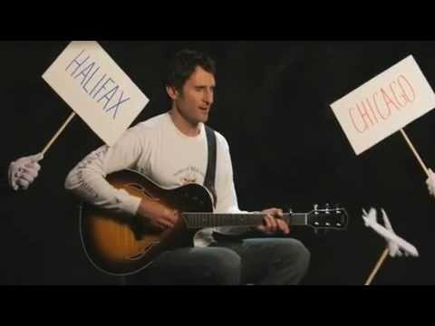
The people behind the brands on social networking sites
In the article, Kietzmann et al. use the case study of Dave Carroll, a Canadian musician, and his experiences with United Airlines to explain the importance of paying attention to your company’s social media presence. The authors explain:
“... when United Airlines broke Dave Carroll’s guitar in 2008, it likely was not the first time a musical instrument had been broken during the course of a flight. It was, however, probably the first time that the owner of the instrument recorded a music video about the experience and posted it on YouTube. The video, portraying United in a very unfavorable light, went ‘viral’ and has been viewed almost 9.5 million times (Carroll, 2009). Amongst other highlights, United Breaks Guitars was cited by Time.com as one of YouTube’s best videos, and even discussed by Wolf Blitzer on television’s CNN Situation Room.”
Notes:
Kietzmann, J. H., Hermkens, K., McCarthy, I. P., & Silvestre, B. S. (2011). Social media? Get serious! Understanding the functional building blocks of social media. Business Horizons, 54(3), 241-251.
Video embedded in photo

Slide 24
The people behind the brands on social networking sites
Such attention led to a brand and public relations crisis for United, as the story was cheered on by a global community of passengers who understood all too well the frustrations of dealing with airline service failures. This high profile example illustrates how ill-prepared firms can be in dealing with social media conversations about them. As BBC Business Editor Tim Weber (2010) explains: ‘‘These days, one witty tweet, one clever blog post, one devastating video--forwarded to hundreds of friends at the click of a mouse--can snowball and kill a product or damage a company’s share price.”
Notes:
Kietzmann, J. H., Hermkens, K., McCarthy, I. P., & Silvestre, B. S. (2011). Social media? Get serious! Understanding the functional building blocks of social media. Business Horizons, 54(3), 241-251.
Weber, T. (2010, October 3). Why companies watch your every Facebook, YouTube, Twitter move. Available: http://www.bbc.co.uk/news/business-11450923

Slide 25
The people behind the brands on social networking sites
This case study has gone on to be highly influential for companies who actively participate in social networking sites. However, as you have experienced first hand in your own experimentations with social networking sites for this course, it is not as simple as creating a profile. Someone must be there behind the scenes to post content and monitor any replies. This has lead to new employment options such as social media managers and community managers.
“A social media manager is responsible for being the brand on social media. They create content, respond to comments, answer questions, and much more as the brand. Social media managers, more often than not, deal with people who have a relationship with, or have heard of, the brand.” (Patterson, 2014, para. 4)
“A community manager is responsible for advocating the brand on social networks. They create their own social persona and actively go out within the online community to connect with potential customers and advocate the brand. Community managers typically deal with those who haven’t heard of the business they work for and boost awareness for the company.” (Patterson, 2014, para. 4)
Notes:
Patterson, M. (2014, October 30). “Social Media Manager vs. Community Manager: What’s the Difference?”. Sprout Social. Available: http://sproutsocial.com/insights/social-media-vs-community- manager/
While the two roles may seem identical, social media managers essentially act as actual brands while community managers represent themselves on behalf of the brand they’re promoting.

Slide 26
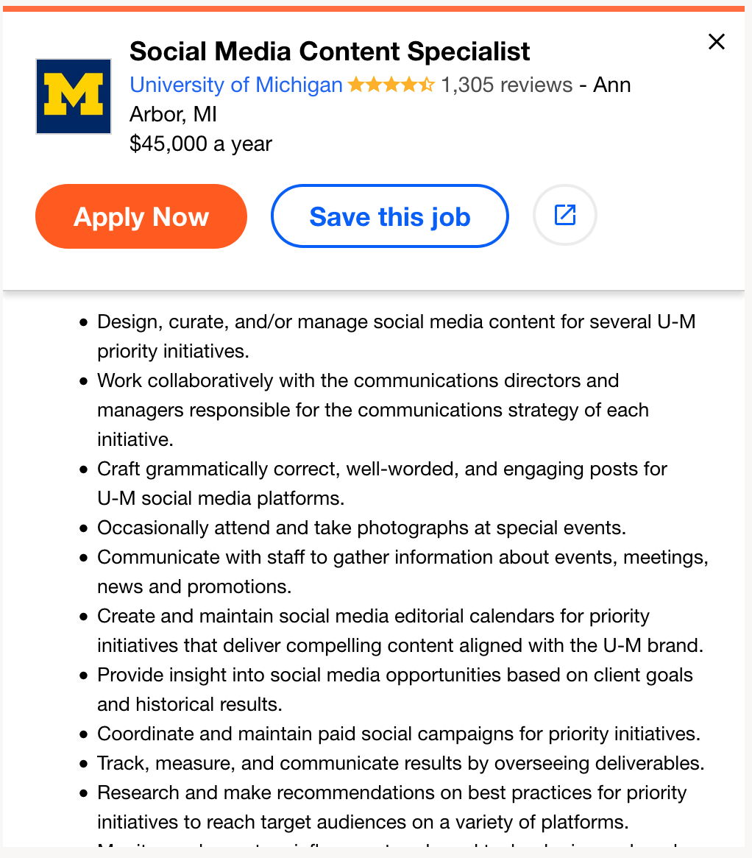
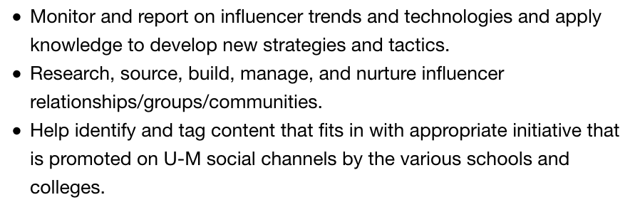
The people behind the brands on social networking sites
Notes:
However, these jobs do not involve merely sitting around all day looking at Facebook. A recent job posting for a “Social Media & Content Specialist” for the University of Michigan described the following duties that their manager would be responsible for this very long list of tasks:

Slide 27
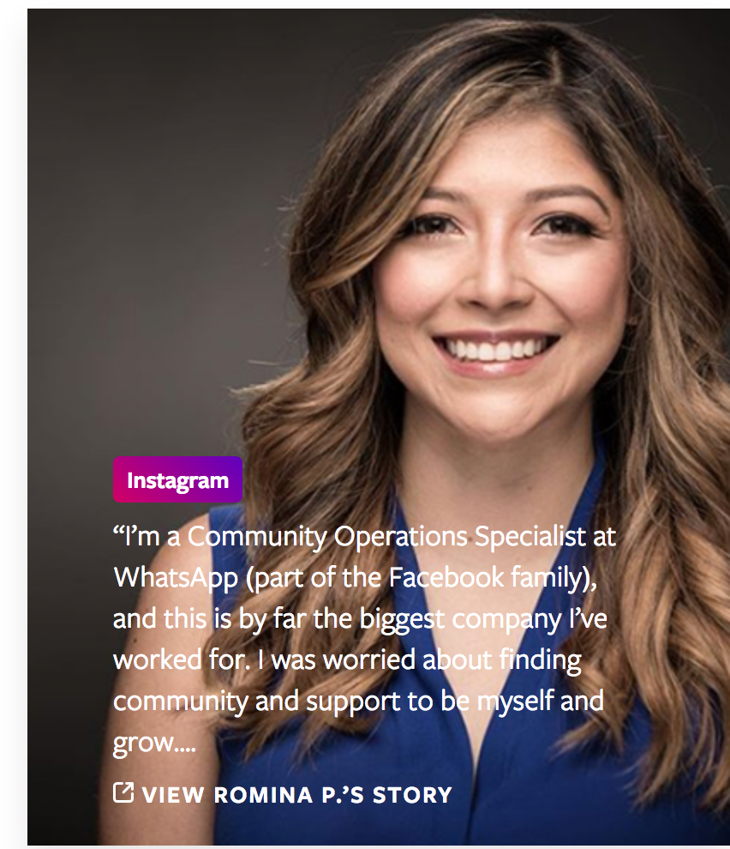
The Invisible Labour of Content Moderators
In 2010 the film The Social Network was released. Based on Ben Mezrich’s 2009 book The Accidental Billionaires, the film depicts the early days of Facebook where Mark Zuckerberg did the majority of the labour to get the site off the ground and running. Since its initial founding in 2003, Facebook has grown to a company that employs over 15,000 people across the globe.
Employees at its California headquarters, located in Menlo Park, work in a state of the art building designed by Frank Gehry that includes an open floor plan and a 9-acre rooftop park. A quick perusal of the Facebook Careers page will not only find job postings but also a series of videos of current employees describing their favourable work conditions and what duties or tasks their job consists of.
Notes:
<<maybe just check this stas>>

Slide 28
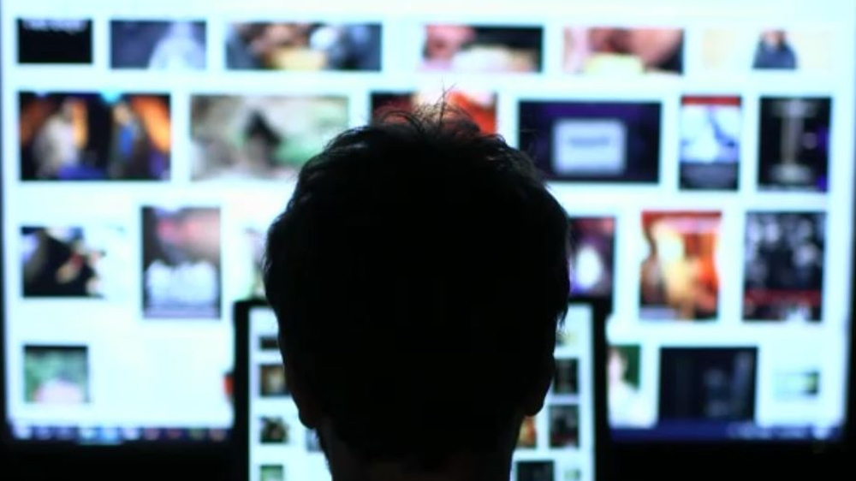
The Invisible Labour of Content Moderators
Not found on this Careers page are the contract workers detailed in the second reading for this module, Adrian Chen’s “The Laborers Who Keep Dick Pics and Beheadings Out of Your Facebook Feed”. Here, Chen described the working conditions of content moderators.
When this article was first published, it made waves because of its frank and eye opening discussion about a job that is rarely talked about. A summary on Gizmodo, a technology-blog, describes Chen’s article as such:
“It's not just Facebook, of course. Pretty much any social media site you can think of uses some sort of moderation to keep abusive content off its pages. Chen specifically visited the offices of a company in the Philippines that handles moderation for Whisper, the not-so-anonymous secret-sharing app. There, contracted workers likely make less in a day than you do in an hour by looking at pictures of everything from child beastiality to brutal violence. This sort of thing takes a toll on content-moderating workers-of whom there are an estimated 100,000 worldwide.” (Clark Estes, 2014)
Notes:
Clark Estes, A. (2014, October 23). “The Horrifying Job of Facebook Content Moderators”. Gizmodo. Available: http://gizmodo.com/the-horrifying-lives-of-facebook-content-moderators-1649825388

Slide 29
The Invisible Labour of Content Moderators
Moderation is necessary to keep the “family friendly” reputation of Facebook intact. Facebook and other social networking sites have made it easy to share content with others. However, it is just as easy for you to upload pictures of your niece’s first birthday is it is for someone who wants to upload disturbing or offensive content. This disturbing content is largely hidden from view because someone else watches it before it has the chance to get to your feed. As Chen so clearly describes, the conditions of these moderators work in are far from ideal and without proper structural support, risk PTSD.
A lawsuit filed by former Microsoft content moderators underscores Chen’s point:
“In the lawsuit filed at the end of last year, Henry Soto and Greg Blauert, who worked at Microsoft’s facility in King County, Washington, claimed that they were tasked with reviewing toxic content - including images and videos of child sexual abuse, people dying, and murder – for years, so they could take it down, and flag it with law enforcement and child protection agencies.
The suit alleges that Microsoft was negligent in its handling of the mental health of the employees on this team - even though the company extended programs and benefits to ensure the welfare of people in its the Digital Crimes Unit, which had similar duties.” (Ghoshal, 2017).
Notes:
Ghoshal, A. (2017, January 12). “Microsoft sued by employees who developed PTSD after reviewing disturbing content”. TNW. Available: https://thenextweb.com/microsoft/2017/01/12/microsoft-sued- by-employees-who-developed-ptsd-after-reviewing-disturbing-content/

Slide 30
The Invisible Labour of Content Moderators
Content moderators are the first (and often only) line of defense for keeping offensive material away from most users’ interactions with the site. If you have been lucky enough not to see any of the content described by Chen’s article, it is likely because a worker saw it before you had a chance to.
Other journalists have also dived into the murky waters of content moderation, finding it extremely difficult to get definitive information about what is or is not moderated on the site. Some content is universally horrific, such as the beheading or abuse photos described in Chen’s article. Other content is a grey area, such as nudity. While some users may not be concerned about a photograph of a woman breast-feeding, another may mark it as offensive.
Notes:
Ghoshal, A. (2017, January 12). “Microsoft sued by employees who developed PTSD after reviewing disturbing content”. TNW. Available: https://thenextweb.com/microsoft/2017/01/12/microsoft-sued- by-employees-who-developed-ptsd-after-reviewing-disturbing-content/

Slide 31
The Invisible Labour of Content Moderators
Content moderation, as Chen’s article shows, is a job that exposes workers to the worst images that get uploaded to social networking sites. After reading Chen’s article, it is understandable why Facebook, YouTube, and other social networking sites do not want to draw any extra attention to the fact that moderation occurs. However, retuning back around to one of the key themes throughout this course has been privacy. An interview with a content moderator pointed out just how much information they have access to when content is flagged for possible moderation:
“The biggest worry for the rest of us, however, is that the moderation process isn’t nearly secretive enough. According to Derkaoui, there are no security measures on a moderator’s computer to stop them uploading obscene material themselves. Despite coming into daily contact with such material, he was never subjected to a criminal record check. Where, then, is the oversight body for these underpaid global police?”
“Facebook itself is guarding them, according to a previous statement to which the Telegraph was referred. ‘These contractors are subject to rigorous quality controls and we have implemented several layers of safeguards to protect the data of those using our service,” it read. “No user information beyond the content in question and the source of the report is shared. All decisions made by contractors are subject to extensive audits.”
“And yet in the images due for moderation seen by the Telegraph, the name of anyone “tagged” in an offending post - as well as the user who uploaded it - could be clearly discerned. A Facebook spokesman said that these names are shared with the moderators to put the content in context - a context sufficient for Derkaoui to claim that he had as much information as “looking at a friend’s Facebook page”. He admits to having subsequently looked up more information online about the people he had been moderating.” (Barnett, 2012)
Notes:
Barnett, E. (2012, March 2). “The Dark Side of Facebook: Our social networking pages are being policed by outsourced, unvetted moderators”. The Telegraph. Available http://www.telegraph.co.uk/technology/facebook/9118778/The-dark-side-of-Facebook.html

Slide 32
The Invisible Labour of Content Moderators
This disclosure by Amine Derkaoui, a content moderator interviewed by Gawker and named in the previous quote, is a reminder that despite all the benefits that can come about by participating in a social networking site, by doing so your data and personal information can be seen by third parties. In most cases it is advertisers who want to sell you something, but if you find something you post being marked as needing moderation, you might find an unexpected visitor on your profile like Derkaoui.
Notes:
Barnett, E. (2012, March 2). “The Dark Side of Facebook: Our social networking pages are being policed by outsourced, unvetted moderators”. The Telegraph. Available http://www.telegraph.co.uk/technology/facebook/9118778/The-dark-side-of-Facebook.html

Slide 33
Summary
In this module we have explored some of the “behind the scenes” labour that goes into keeping your favourite social networking site afloat. Data centers are the technological backbone to these sites, storing your profile and allowing both you and your followers to access it on demand. But because of “the cloud” the physical infrastructure is something that rarely needs to be considered by the average user. This lack of consideration is unfortunate, as data centers have a significant environmental footprint that is largely ignored because we are so dependent on them for our favourite sites and search engines to operate.

Slide 34
Summary
In addition to the physical infrastructure that is hidden from view, we also looked at the invisible labour that goes on behind the scenes. This included the amount of time and effort that goes into your favourite viral media star’s latest video, and how difficult it can be to make a living creating social media content.
As social networking sites grow, more and more companies are finding themselves needing to have a social media presence to connect and interact with their customers. The “United Breaks Guitars” case study serves as an example of why active engagement is necessary, lest a customer complaint goes viral and tarnishes the company’s reputation. In order for this presence to be effective, dedicated employees must be assigned to “be the brand” on social media. A look at a recent job posting for a social media manager for an international company showed just how much work goes into such positions.

Slide 35
Summary
Finally, we looked at the world of content moderation. This is largely hidden from view because of the disturbing nature of this work. And yet, it is some of the most important work that needs to be done, as it allows social networking site users to go about their daily interactions with the site without fear of seeing unsettling photos or videos.
Taken together, these examples of behind the scenes labour illustrate just how much work goes into the social networking sites we use and enjoy. Much of this work is obscured from view because once again we come back to the question of how these sites make money. By keeping users entertained and shielded from the darker sides of social media, it ensures they spend more time on the site which in turn generates more data that can be used in the profiles sold to advertisers.

Slide 36
Lecture 12: Invisible Labour
In this module we have explored some of the “behind the scenes” elements of social media including:
That data centers are what allow “the cloud” to exist.
The amount of labour that goes into creating social media content that may or may not lead to adequate financial compensation and therefore is a form of precarious labour.
That brands and companies must make the same decision about whether or not to participate in social networking sites.
Content moderation uses contract workers who are tasked with seeing all reported images in videos. This is done to maintain the safe and family-friendly atmosphere of most social networking sites, but can be at the cost of the mental well-being of these workers.

Slide 37
For next week:
Next week’s class (August 16th) will be in-person!
Lecture material will be made available online and must be read before class
Ensure you post one tweet and two replies on Twitter before our next meeting on the topic of Invisible Labour
Note! Summative Course Reflection due August 16th

